Slide 1
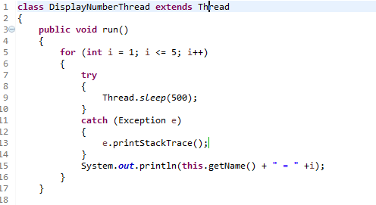
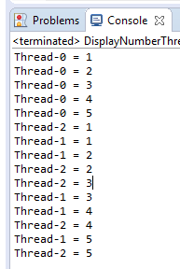
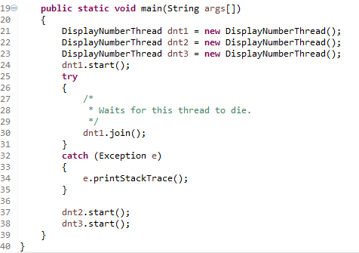
The join() method
After dnt1 [Thread-0] completes its task then dnt2 [Thread-1] and dnt3[Thread-2] starts executing.
The join() method waits for a thread to die.

Slide 2
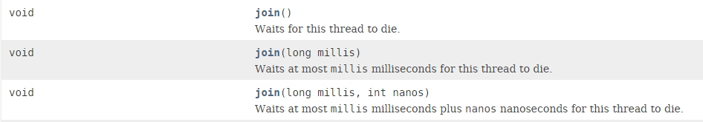
The join() method

